Slide 1
Presentation on Ring Topology
By- Md. Kausar Habib
ID. – 1202483, Round – 28
Batch – ID-NT/ACSL/01M/R-28/01

Slide 2
What is Network Topology?
Topology is a usually schematic description of the arrangement of a network, including its nodes and connecting lines.
There are two ways of defining network geometry: the physical topology and the logical (or signal) topology.

Slide 3
History of network topologies?
The history of network topologies dates back to 1969-1970. This what when Roberts, who is now known as Dr. Howard, started researching on network topologies and founded Network Analysis Corporation.

Slide 4
What does Ring Topology mean?
Ring topology refers to a specific kind of network setup in which devices are connected in a ring and pass information to or from each other according to their proximity in the ring structure.
This type of topology is highly efficient and handles heavier loads better than bus topology.
A ring topology may also be called an active topology because messages are passed to each device in the ring.

Slide 5
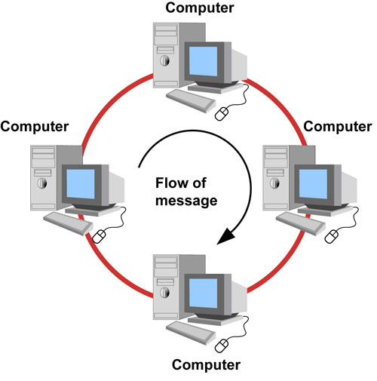
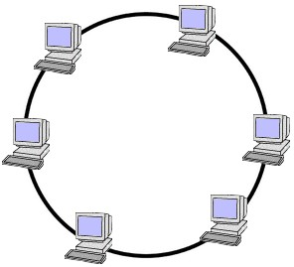

Slide 6
Advantages of Ring Topology
Enables reliable communication
Handles high-volume network traffic
Data is quickly transferred without a ‘bottle neck’. (very fast, all data traffic is in the same direction)
Adding additional nodes has very little impact on bandwidth
Easier to manage; easier to locate a defective node or cable problem
Well-suited for transmitting signals over long distances on a LAN

Slide 7
Advantages of Ring Topology
Performs better than a bus topology under heavy network load
Does not require a central node to manage the connectivity between the computers
It is quite easy to install and reconfigure since adding or removing a device requires moving just two connections.
Point to point line configuration makes it easy to identify and isolate faults.

Slide 8
Disadvantages of Ring Topology
Expensive
Requires more cable and network equipment at the start
Moving, adding and changing the devices can affect the network
Communication delay is directly proportional to number of nodes in the network
Bandwidth is shared on all links between devices
More difficult to configure than a Star: node adjunction = Ring shutdown and reconfiguration

Slide 9
Disadvantages of Ring Topology
If any of the nodes fail then the ring is broken and data cannot be transmitted successfully.
It is difficult to troubleshoot the ring.
In order for all computers to communicate with each other, all computers must be turned on.
Total dependence upon the one cable

Slide 10
Thank You

